Slide 1

Objects and Classes
Module 7

Slide 2
Topics
Classes
Mutators and accessor methods
Initialization and constructors
Objects
Constructor overloading
‘this’ parameter
Wrapper classes

Slide 3
Classes
In an object-oriented programming language, like Java, you create programs that are made of objects.
In software, an object has two capabilities:
An object can store data.
An object can perform operations.
The data stored in an object are commonly called attributes or fields.
The operations that an object can perform are called methods.

Slide 4
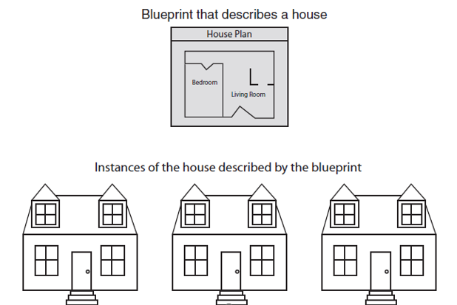
Classes and Instances
Many objects can be created from a class.
Each object is independent of the others.

Slide 5
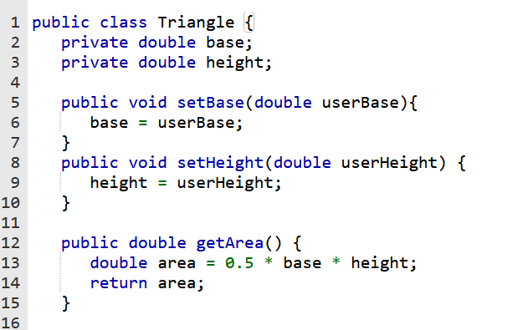
Access Modifiers
An access modifier is a Java key word that indicates how a field or method can be accessed.
There are three Java access modifiers:
public
private
protected

Slide 6
Access Modifiers
Classes that need to be used by other classes are typically made public.
If there is more than one class in a file, only one may be public and it must match the file name.
public: This access modifier states that any other class can access the resource.
private: This access modifier indicates that only data within this class can access the resource.
protected: This modifier indicates that only classes in the current package or a class lower in the class hierarchy can access this resource.

Slide 7
Encapsulation
Classes should be as limited in scope as needed to accomplish the goal.
Each class should contain all that is needed for it to operate.
Enclosing the proper attributes and methods inside a single class is called encapsulation.
Encapsulation ensures that the class is self-contained.

Slide 8

Designing a Class
When designing a class, decisions about the following must be made.
what data must be accounted for
what actions need to be performed
what data can be modified
what data needs to be accessible
any rules as to how data should be modified

Slide 9
Attributes
The data elements of a class define the object to be instantiated from the class.
The attributes must be specific to the class and define it completely.
Example: A rectangle is defined by
height
width
The attributes are then accessed by methods within the class.

Slide 10
Data Hiding
Another aspect of encapsulation is the concept of data hiding.
Classes should not only be self-contained, but they should be self-governing as well.
Classes use the private access modifier on fields to hide them from other classes.
Classes need methods to allow access and modification of the class's data.

Slide 11
Accessors and Mutators
Because of the concept of data hiding, fields in a class are private.
The methods that retrieve the data of fields are called accessors.
The methods that modify the data of fields are called mutators.
Each field that the programmer wishes to be viewed by other classes needs an accessor.
Each field that the programmer wishes to be modified by other classes needs a mutator.

Slide 12
Accessors and Mutators
For a Rectangle class, the accessors and mutators are:
setHeight : Sets the value of the height field.
public void setHeight(double h) …
setWidth : Sets the value of the width field.
public void setHeight(double w) …
getHeight : Returns the value of the height field.
public double getHeight() …
getWidth : Returns the value of the width field.
public double getWidth() …
Other names for these methods are getters and setters.

Slide 13
Class Layout Conventions
The layout of a source code file can vary.
Generally, the layout is:
Attributes are typically listed first
Methods are typically listed second
The main method is sometimes first, sometimes last.
Accessors and mutators are typically grouped.

Slide 14
A Driver Program
public class Rectangle
{
private double width;
private double height;
public void setWidth(double w)
{ width = w;
}
public void setHeight(double h)
{ height = h;
}
public double getWidth()
{ return width;
}
public double getHeight()
{ return height;
}
public double getArea()
{ return height * width;
}
}
public class RectangleDemo
{
public static void main(String[] args)
{
Rectangle r = new Rectangle();
r.setWidth(10);
r.setHeight(10);
System.out.println("Width = "
+ r.getWidth());
System.out.println("Height = "
+ r.getHeight());
System.out.println("Area = "
+ r.getArea());
}
}

Slide 15
Constructors
Classes can have special methods called constructors.
Constructors are used to perform operations at the time an object is created.
Constructors typically initialize instance fields and perform other object initialization tasks.

Slide 16
Constructors
Constructors have a few special properties that set them apart from normal methods.
Constructors have the same name as the class.
Constructors have no return type (not even void).
Constructors may not return any values.
Constructors are typically public.

Slide 17
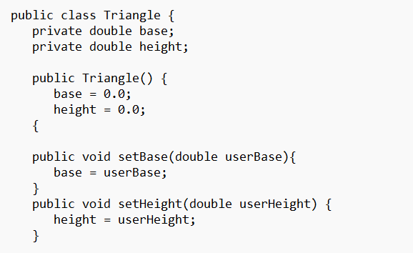
The Default Constructor
If a constructor is not defined, Java provides a default constructor.
It sets all the class's numeric fields to 0.
It sets all the class's boolean fields to false.
It sets all the class's reference variables; the default constructor sets them to the special value null.
The default constructor is a constructor with no parameters.
Default constructors are used to initialize an object in a default configuration.

Slide 18
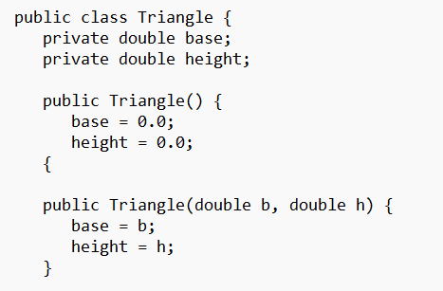
Overloaded Constructors
Java allows overloaded constructors
Must differ by different data types passed into the parameter list
Or must differ in the number of values passed into the parameter list

Slide 19
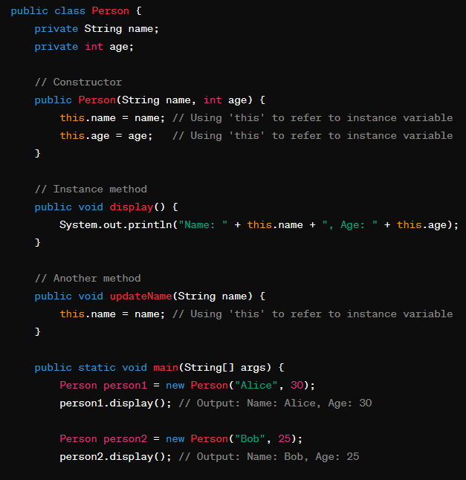
this Parameter
this is a keyword in Java that refers to the current instance of the class in which it appears. It represents the object on which the method is being invoked.

Slide 20
End of Module

